Slide 1
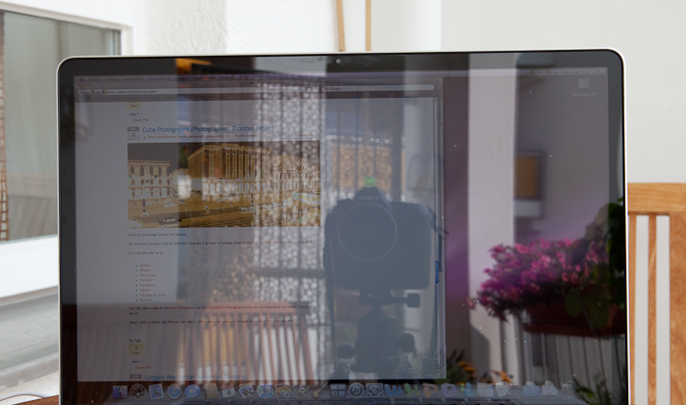
http://www.strongmocha.com/images/apple/macbook%20pro/nonglare%20glare/MacBook%20Pro%20Glare%201_MG_9286.jpg

Slide 2
Age of Ultrasound
Kunal Rai, Aaryan Jadhav, Shryans Goyal,
Chuck Wang, Denizhan Yigitbas
Notes:
slides are not loaded, diagrams are clearly understood and labelled properly, display of data that is easy to understand

Slide 3
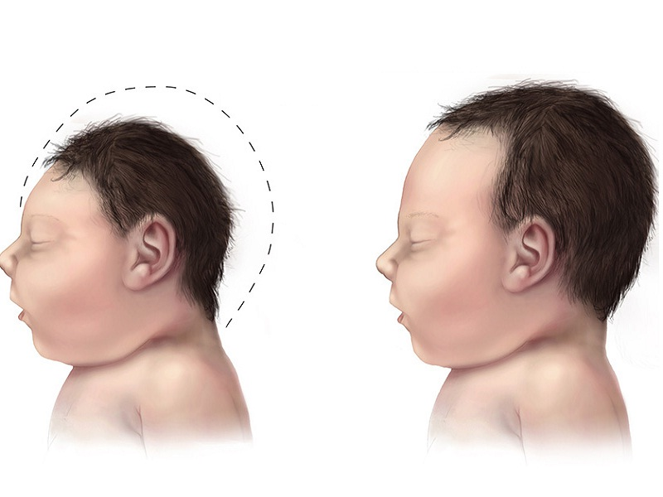
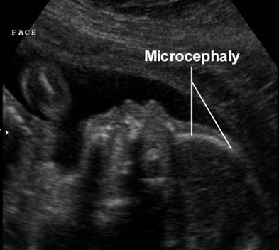
Lack of Ultrasound Specialists in Low Resource Clinics
Necessary to transfer ultrasound image data to specialists in other locations
Diagnosing fetal microcephaly in Zika infected mothers
Microcephaly is a birth defect where the head is smaller and undeveloped
http://image.techtimes.com/data/images/full/215552/microcephaly.jpg
http://www.fetalultrasound.com/online/text/1-024_files/image013.jpg

Slide 4
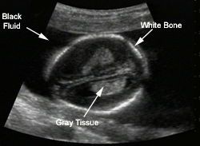
http://www.fetal.com/Genetic%20Sono/Text/02%20Detection%20Routine%20US/Bone%20Tissue%20fluid%20copy.jpg

Slide 5

Existing Method - Point and Shoot
Smartphones (iPhone & Android) or flip phone cameras used
Rough judgement to get best image
Image sent through internet applications
Ex. WhatsApp, SMS, Email
Compression of the image file occurs

Slide 6
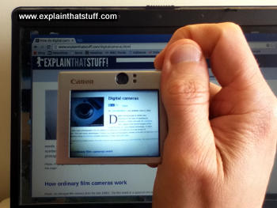
Problems with Current Method
Judgement to capture best photo varies
Produces poor quality photos
Glare
Inadequate lighting
Clarity of image
Low contrast
Pixelated image
Photo captures surroundings of ultrasound
https://cdn4.explainthatstuff.com/taking-digital-photo.jpg

Slide 7
Create a physical device that will improve the quality of images captured of ultrasound screens.
Problem Statement

Slide 8
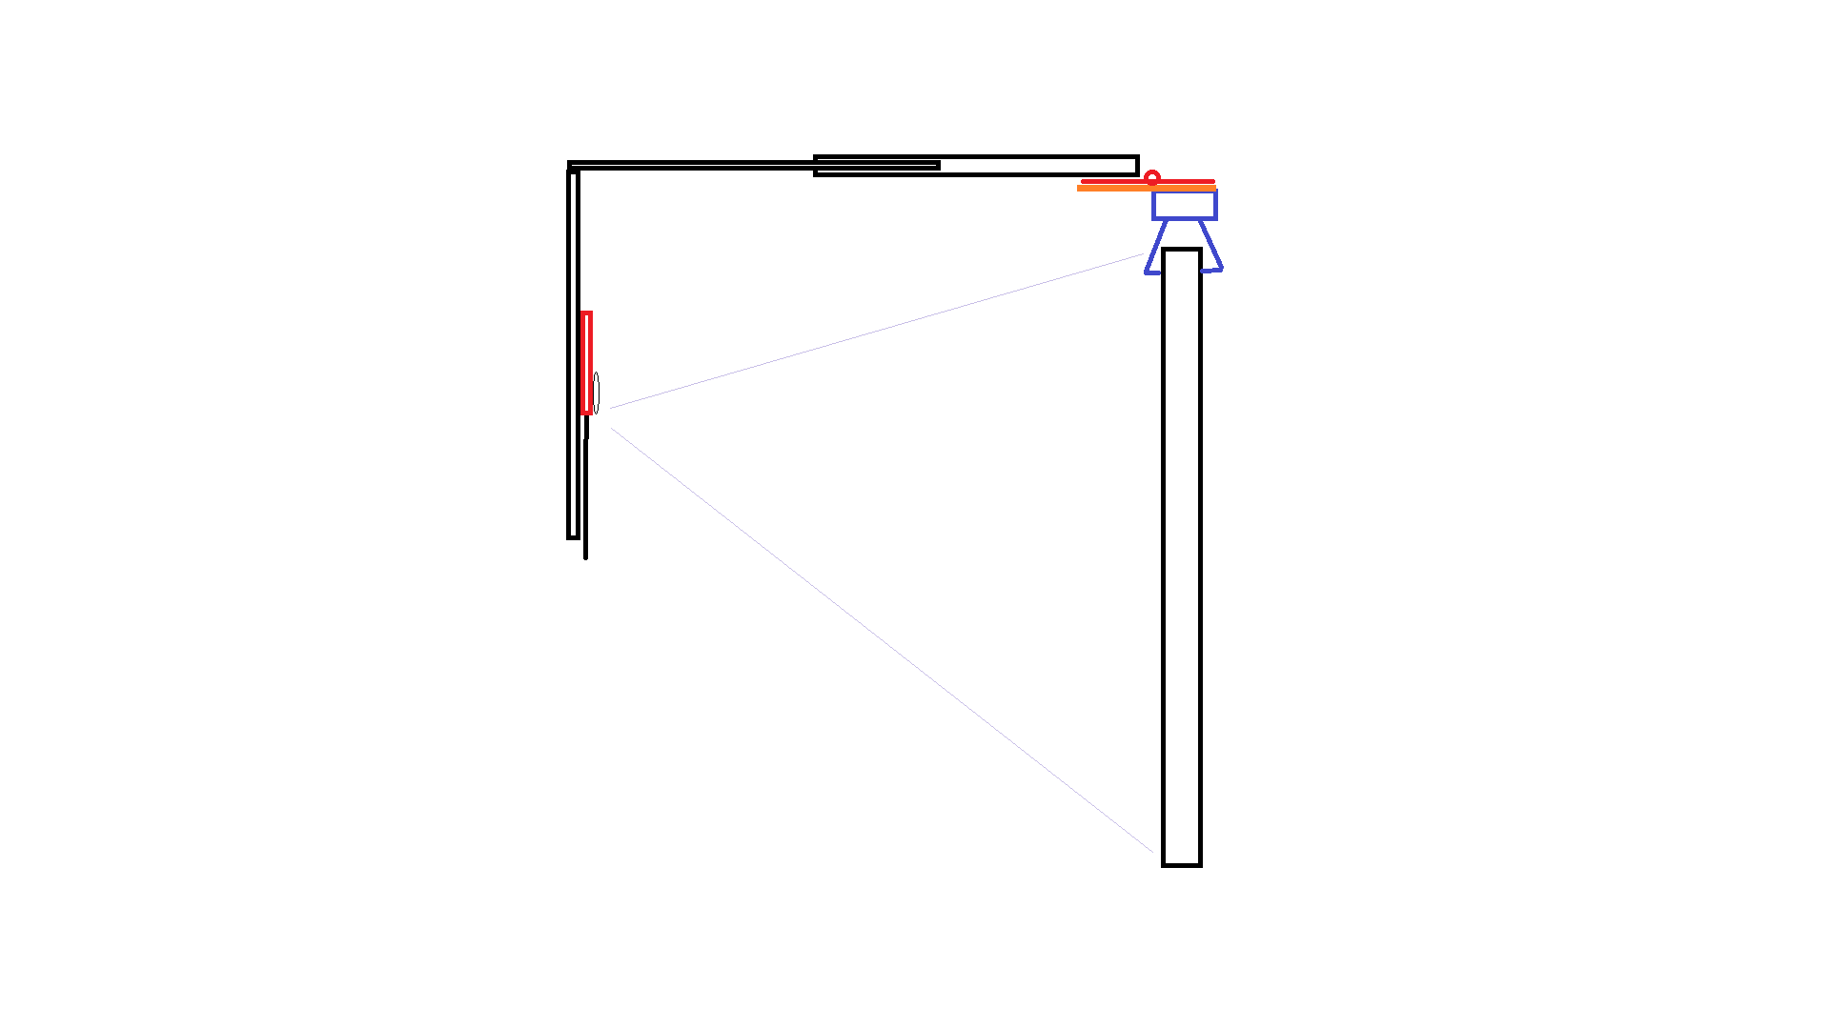
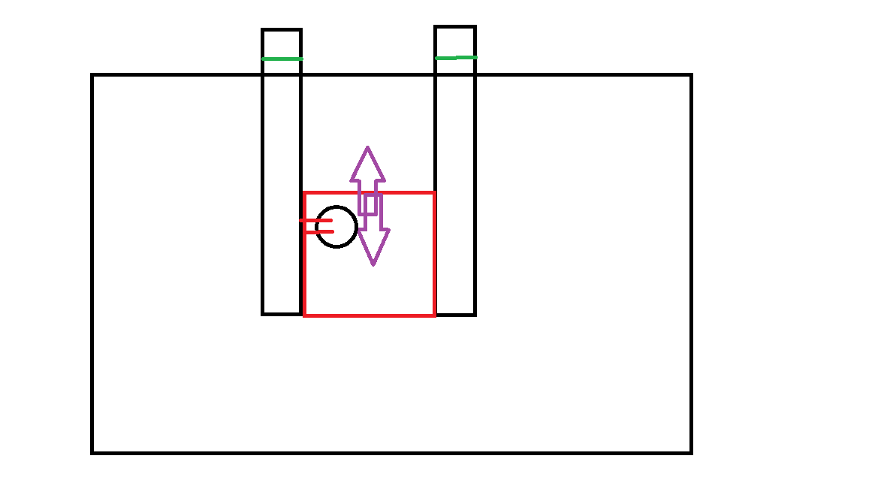
Preview of Selected Solution

Slide 9
Main Components
A stabilizing mechanism for the mobile phone
An anti-glare mechanism for the screen or the mobile phone
Variable design so that the solution can fit a variety of machines and phones

Slide 10
Design Constraints | Target Value
Percent of image that is the ultrasound | 85% of the photo should be the ultrasound given there is elimination of glare and artifacting.
Sanitizable with alcohol | Can be washed without damaging components or functionality (no porous materials or cloth)
No magnetic components | The solution does not contain ferromagnetic materials

Slide 11
Quantitative Design Criteria
Design Objective | Target Value
Grayscale | >100 / 256 different shades must be present
Glare | > 85% of the ultrasound image must be free of glare
Ease of use | <2 minute setup time
Affordable | < $15 (bill of materials)
Durability | Survives 5 drop tests at 5ft
Easy to learn | ≥4 on User Defined Scale

Slide 12
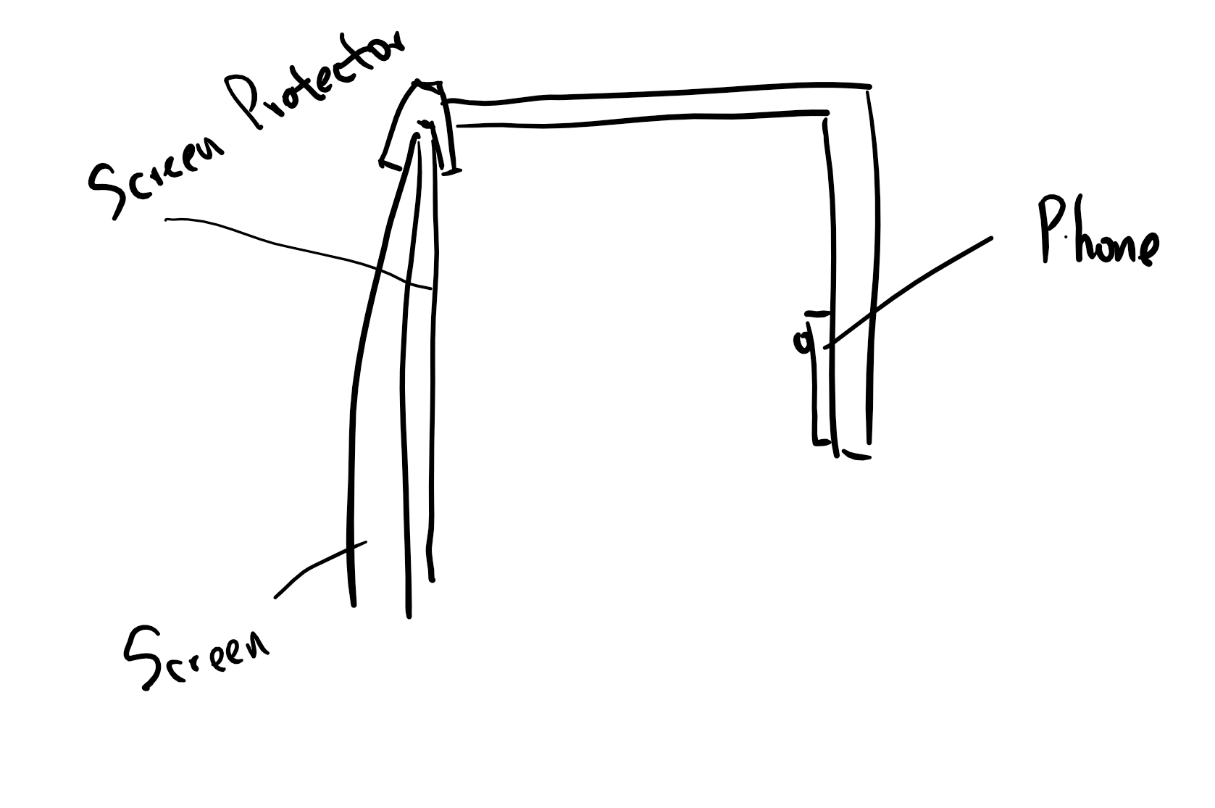
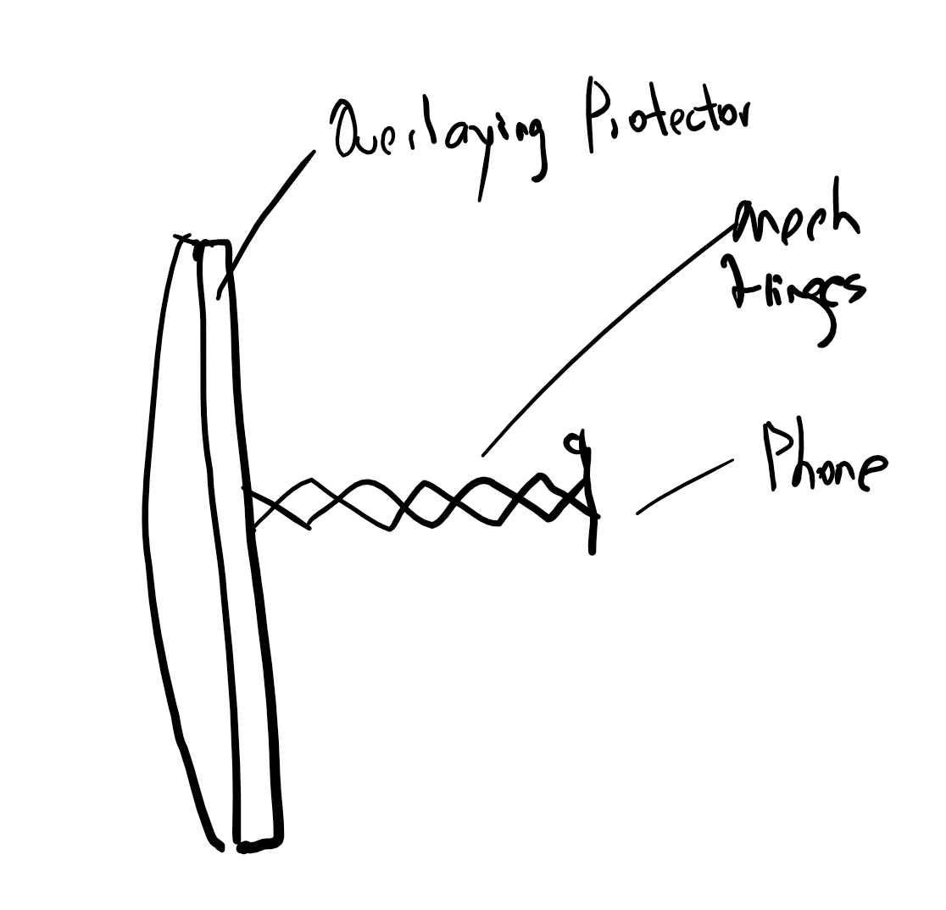
Concepts Going into Pugh Scoring
Flipped frame with screen protector
Folding Mechanism: Flipped frame
Anti Glare Mechanism: Permanent screen protector for the ultrasound screen
Mechanical Hinges with Overlaying Protector
Folding Mechanism: Adjustable monitor stand- multiple hinges for easy adjustment
Anti Glare Mechanism: Overlaying removable screen protector

Slide 13
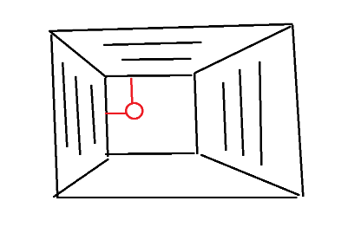
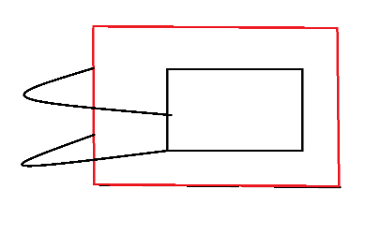
Concepts Going into Pugh Scoring
Pyramid with Clip on Frame and Lens
Folding Mechanism: Pyramid shaped clip-on frame that can adjust light coming into the frame
Anti Glare Mechanism: Polarized lens on phone camera
Mirror with Flexible Legs
Folding Mechanism: Mirror attached to side of ultrasound machine by hinges and flexible stands
Anti Glare Mechanism: Overlaying removable screen protector
Ultrasound Screen
Mirror

Slide 14
Pugh Matrix to Support Choice of Solutions
Design Criteria | Weighting | FF* and Overlaying Protector | Mech. Hinges with Overlaying Protector | FF* and Screen Protector | Clip-on Pyramid Frame and Lens | Mirror with Flexible Legs
Glare | 20% | 3 | 3 | 4 | 5 | 4
Grayscale | 20% | 2 | 2 | 3 | 4 | 5
Ease of Use | 20% | 3 | 3 | 4 | 2 | 1
Affordability | 20% | 5 | 5 | 3 | 2 | 4
Durability | 15% | 4 | 3 | 4 | 2 | 1
Easy To Learn | 5% | 5 | 4 | 5 | 3 | 3
Score | 100% | 3.45 | 3.25 | 3.65 | 3.05 | 3.10
Rank |  | 2 | 3 | 1 | 5 | 4
*FF=Flipped Frame

Slide 15
Pugh Matrix to Support Choice of Solutions
Design Criteria | Weighting | FF* and Overlaying Protector | Mech. Hinges with Overlaying Protector | FF* and Screen Protector | Clip-on Pyramid Frame and Lens | Mirror with Flexible Legs
Glare | 20% | 3 | 3 | 4 | 5 | 4
Grayscale | 20% | 2 | 2 | 3 | 4 | 5
Ease of Use | 20% | 3 | 3 | 4 | 2 | 1
Affordability | 20% | 5 | 5 | 3 | 2 | 4
Durability | 15% | 4 | 3 | 4 | 2 | 1
Easy To Learn | 5% | 5 | 4 | 5 | 3 | 3
Score | 100% | 3.45 | 3.25 | 3.65 | 3.05 | 3.10
Rank |  | 2 | 3 | 1 | 5 | 4
*FF=Flipped Frame

Slide 16
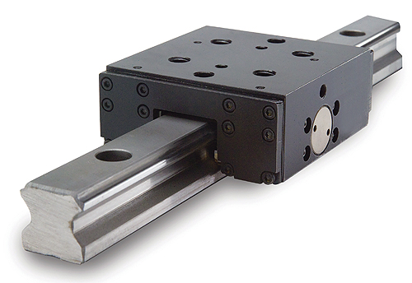
Specific Features and Material Choice of Top Solution from Pugh Scoring
Flipped frame
Plastic rods connected through hinges that fold on top of the machine
Adjustable via linear slide mechanism
Screen Protector
Screen filter that adjusts for glare (matte finish)
Perforated to be able to fit any size screen
http://1ugn2l2m3z2y31d4y73c1m5w.wpengine.netdna-cdn.com/wp-content/uploads/2015/02/nexen-rail-brake.jpg

Slide 17
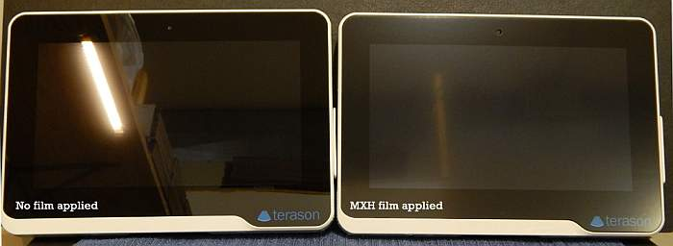
Impact of Matte Screen Protectors on Glossy Surfaces
https://www.photodon.com/c/LCD-Protective-Films.html

Slide 18
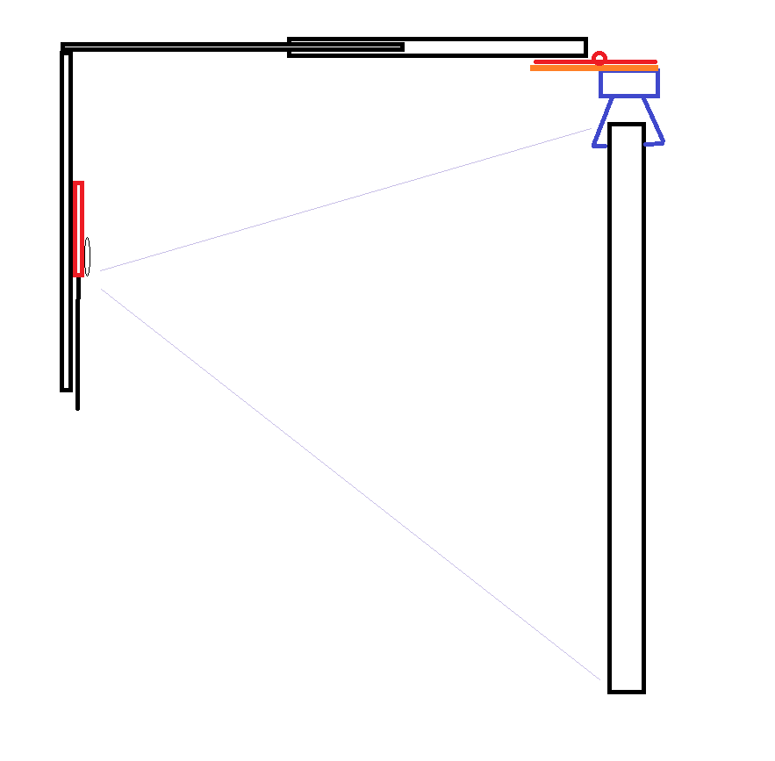
Side View of Flipped Frame with Screen Protector
Hinge
0.75 inches in width, 1 inch in total length
Clamp for Phone
Horizontal Variable Arm
Length: 6 inches extendable up to 10
Width: 1 inch per arm (2 arms total)
Height: .5Inch
Clamp
5 inches long, 2 inches in width, 2 inches in height
Platform to Limit Hinge
1.25 inches in length, 0.75 inches in width
Lens for Phone
Size untested
Vertical Variable Arm
1.5 Inches apart, 6 inches in length, clamp varies up to 4 inches
Ultrasound Screen
Varying diagonal size
Screen Protector

Slide 19
Front View of Flipped Frame with Screen Protector
Clamp
Ultrasound screen
Variable vertical arm
Polarizing lens
Clamp for phone

Slide 20
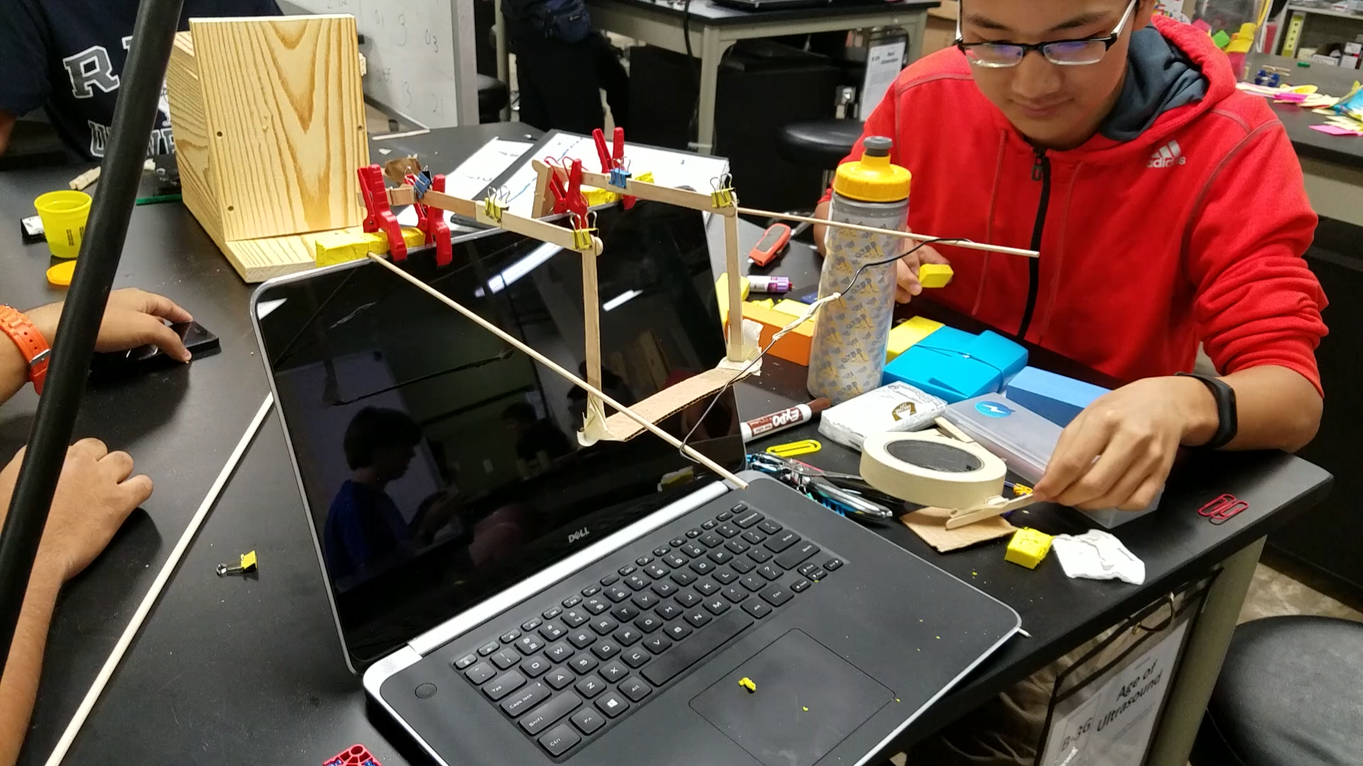
Low Fidelity Prototype of Selected Solution

Slide 21
Preview of Future Plans
Test a scale prototype on mock ultrasound machines (LCD monitors and ultrasound machine screen)
Re-evaluate and improve prototypes
Develop CAD model for flipped frame with screen protector design
Develop a medium fidelity prototype of our solution
Continue correspondence with on site specialists to get feedback

Slide 22

Acknowledgements
Dr. Wettergreen
TA: Keshav Rao
Clients: Dr. Richardson & Dr. Sanz Cortes
Writing Mentor: Lauren Poole

Slide 23
Summary
Goal
Develop a device to improve quality of ultrasound photos
Final Solution
Flipped frame with a screen protector
Current Developments
Testing and potential re-evaluation
Low fidelity prototype developed
Impact
Improvement of diagnosis → public health impact

Slide 24
Appendix

Slide 25
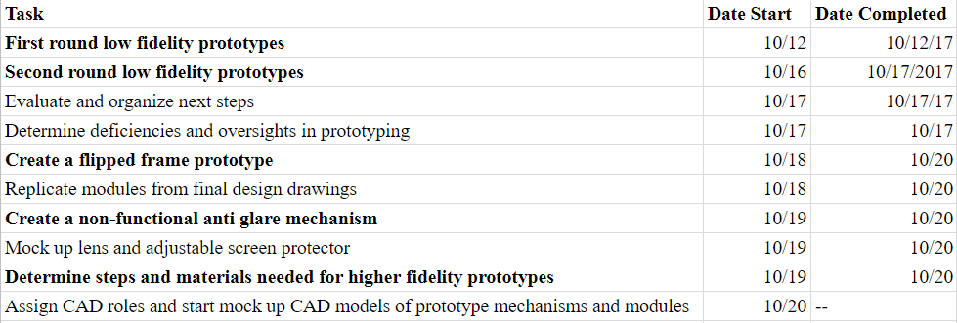
2 Week Plan for Low Fidelity Prototyping

Slide 26
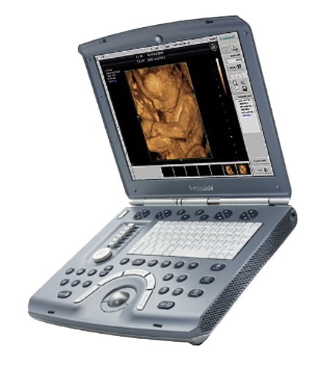
Background Research
Other machines used
VScan, Handhelds, Stationary
Mobile Phone Penetration
60% in target regions of Colombia, Costa Rica
Typical camera quality
3-9 Megapixels
HIPAA Regulations
Confidential patient information is shown in all ultrasounds
http://www.ultrasolutions.com/sites/default/files/images/ge-voluson-i-large-01.png

Slide 27
Pairwise Comparison Chart
 | Affordable | Durable | Easy to learn | Easy to use | Readable | Total
Affordable | --- | 1 | 1 | 1/2 | 0 | 2.5
Durable | 0 | --- | 1 | 0 | 0 | 1
Easy to learn | 0 | 0 | --- | 0 | 0 | 0
Easy to use | 1/2 | 1 | 1 | --- | 0 | 2.5
Readable | 1 | 1 | 1 | 1 | --- | 4

Slide 28
User Defined Scale: Easy to Learn
Ranking | Scale for Easy to Learn
5 | Only requires a diagram to learn how to use
4 | Requires step by step walkthrough
3 | Requires multiple sets of instructions and diagrams to explain
2 | Requires multiple people to understand how to setup
1 | Instructions and multiple people still unable to setup device

Slide 29
User Defined Scale for Glare
Anti-Glare Scale | Value as a percentage of the ultrasound image that is free of glare
5 | More than 95%
4 | From 90% to 95%
3 | From 85% to 90%
2 | From 80% to 85%
1 | Less than 80%

Slide 30
Scoring Scale for Durability
Score | Value
5 | Survive a drop greater than 7 feet
4 | Survives a drop from between 5 feet and 7 feet
3 | Survives a drop from between 3 feet and 5 feet
2 | Survives a drop from between 1 feet and 3 feet
1 | Survives a drop from less than 1 feet or does not survive any drop

Slide 31
Scoring Scale for Easy to Use
Score | Value
5 | <1 minute to use
4 | 1 to 1.5 minutes to use
3 | 1.5 to 2 minutes to use
2 | 2 to 2.5 minutes to use
1 | >2.5 minutes to use

Slide 32
Scoring Scale for Grayscale
Score | Value on the 8-bit Grayscale from 0-256
5 | 200-256
4 | 150-200
3 | 100-150
2 | 50-100
1 | 0-50

Slide 33
Scoring Scale for Affordability
Score | Value
5 | Manufacturing cost lower than 5$
4 | Manufacturing cost from 5$ - 10$
3 | Manufacturing cost from 10$ - 15$
2 | Manufacturing cost from 15$ - 20$
1 | Manufacturing cost higher than 20$

Slide 34
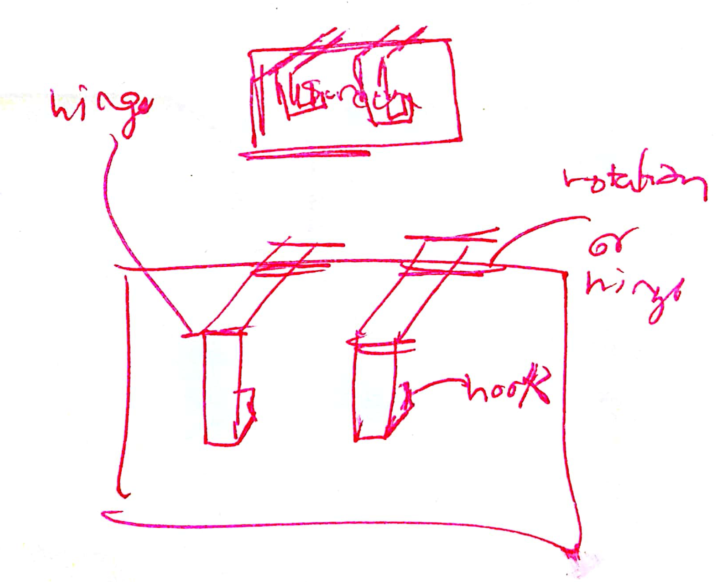
Sketch of flipped frame solution

Slide 35
Justification for Weightings
To weigh criteria, we looked at the Pairwise Comparison Chart and also how important each criteria was for the success of the solutions present. Initially weightage was 0.15 to durability, 0.20 to ease of use, 0.05 to easy to learn, 0.20 to affordable, and 0.4 to readability.
Readability had the most weight as it was crucial that the solution permitted the largest possible variety of grayscale so that the ultrasound image could be read.
Ease of use and affordability had half the value of readability and were weighted the same because the affordability of the solution was important so that it could reach all clinics in low resource areas but just as important was its implementation. The cost and time needed to use the solution were equally important to the solution being successful.
Durability was weighted 0.15 as it was important but not as important as affordability since the cost is a limiting factor for clinics. Easy to learn was weighted the least as the learning curve for the solution does not matter as much as the rest of the criteria. we realized that since our components were made of 2 sets of ideas, stabilizing and anti-glare, readability on its own would not be enough to asses the last solutions. To mitigate this issue we decided to split readability into two components solely for the purpose of the pugh scoring sets. Readability became 0.2 which assessed variety of grayscale present and anti-glare which became 0.2 to assess how well the solution reduces artifacting and glare.

Slide 36
References
(Dr. Magda Sanz Cortes, Client Update, October 12th, 2017)
(Dr. Magda Sanz Cortes, Client Update, September 30th, 2017)
(Dr. Richardson, Client Update, September 16th, 2017

